Slide 1

UNIX - Fundamentals
7
Simple Filters
9
SED
5
The shell
cmp comm diff head and tail …
Inserting
Updating
Deleting
RegEx….
1
UNIX Intro
3
Unix File System
Pattern matching
Escaping Redirecting…
The UNIX OS
The Linux OS
Features of Unix
The file
pwd and cd
mkdir
ls and cp ..
Shell Programming
8
GREP
10
6
The Processes
The character class
The *
The Dot…
condition eval
loops
read
exit status
4
Vi/Vim editors
ps nohup at and batch
2
Unix Commands
Input mode
Saving text
Aborting…
command basics
man
echo
printf …
Biz Nigatu
Software Engineer and Instructor
reckonedforce.com
@bizNigatu

Slide 2
Section 10 – UNIX Fundamentals
Shell Scripts
read: Making Scripts Interactive
Using Command-Line Arguments
exit and $?: Exit Status of a Command
The Logical Operators && and ||
The if Conditional
Using test and [ ] to Evaluate Expressions
Numeric Comparison,
String Comparison,
File Attribute Tests,
Using Compound Conditions
Two Important Programming Idioms:
Running a Tasks
Calling a Script by Different Names ($0)
The case Conditional
Using Wild Cards and the |
expr, and bc
for: Looping with a List
while: Looping
Handling Redirection in a Loop
Using while to Wait for a File
Finding Out Users’ Space Consumption
break and continue
Providing Numeric Extensions to Backup Files
Manipulating Positional Parameters
set and shift
The IFS Variable
Shell Functions
trap: How a Script Handles Signals
eval: Evaluating Twice

Slide 3
Chapter 13 - *** Shell Programming, Part I

Slide 4
Shell Programming Basics
When a group of commands have to be executed regularly, they should be stored in a file, and the file executed as a shell script or shell program.
It’s not mandatory, using the .sh or .bash extension for shell. It is only to differentiate them from compiled programs such as C, C++, etc.
A shell script needs to have execute permission when invoked by its name.
They are typically used to automate routine tasks and are often scheduled to run noninteractively with cron.
Most constructs borrowed from the C programming language developed in the early 70s
Not recommended for number crunching
External UNIX commands blend easily with the shell’s internal constructs in shell scripts

Slide 5
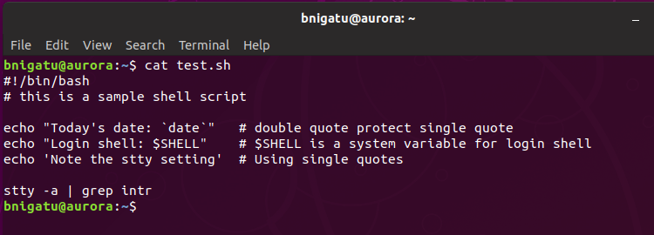
Sample shell script script.sh
You can use text editor such as vi to write shell script
‘#!/bin/sh’ is a Shebang which identifies what program is used to interpret the script. This one uses Bourne shell.
Bash (bourn again shell) has a shebang of #!/bin/bash
A sample shell script: script.sh

Slide 6
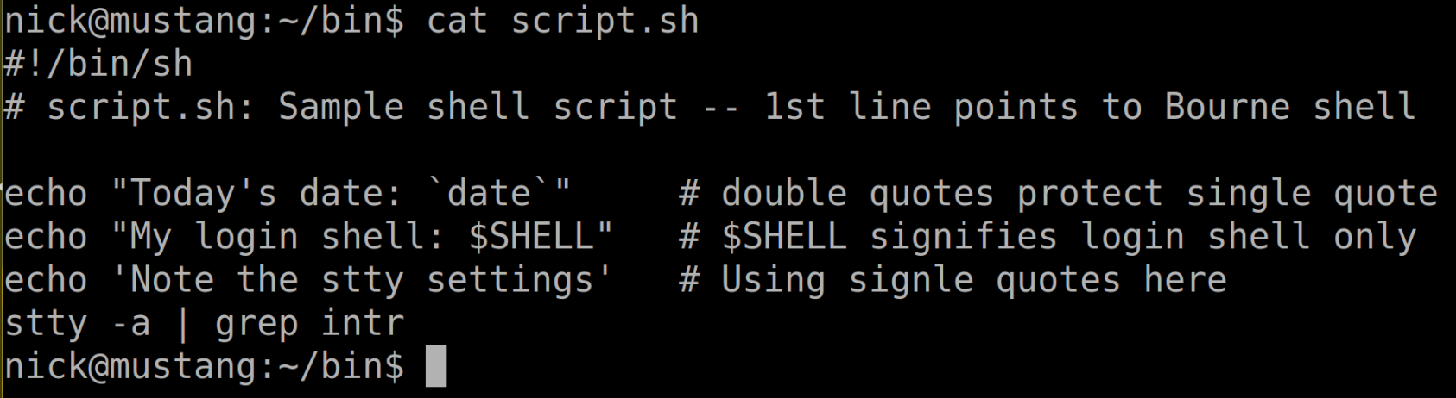
A Simple Shell Script
#!(hash-bang) also known as shebang ‘#!/bin/bash’ Identify what program will be used to interpret the script. In this case it is bash
Comments start with ‘#’
‘bash script.sh’ will spawn a Bash shell
When run this way, script.sh does not have to be executable

Slide 7
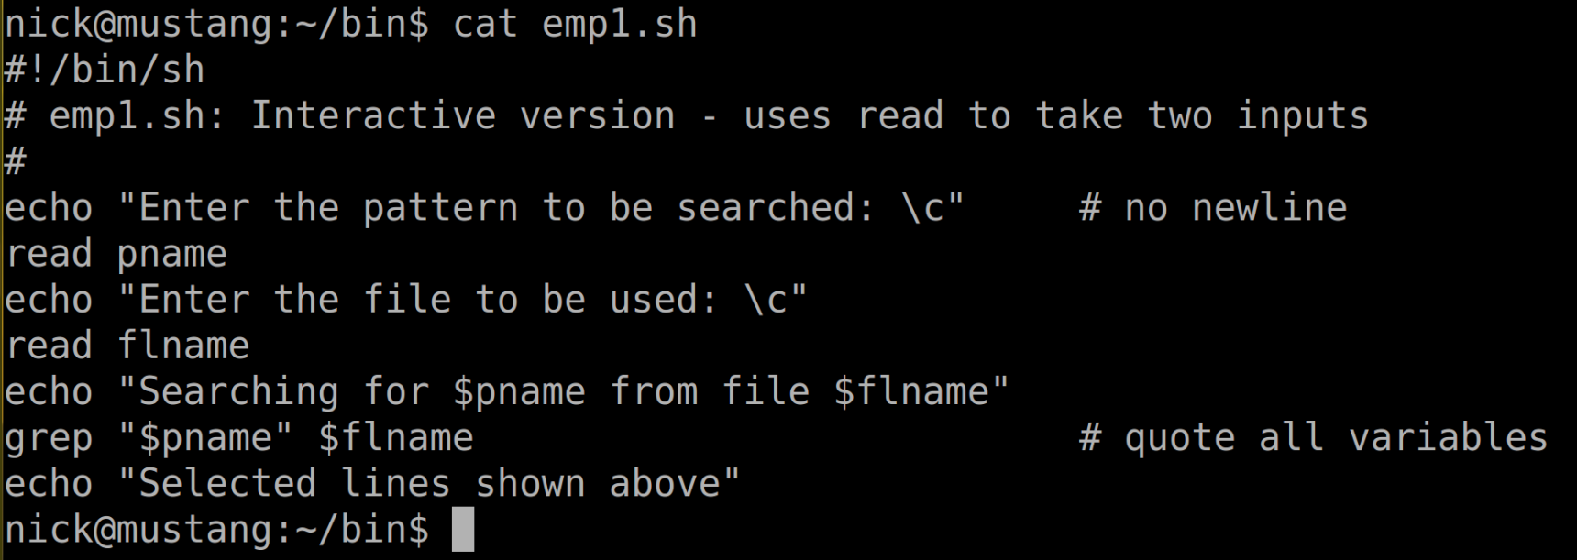
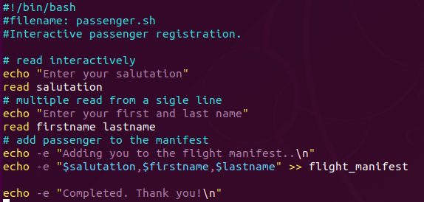
read: Making Scripts Interactive
The read statement is the shell’s internal tool for taking input from the user, that is to make scripts interactive.
Input #1: Single input
Input #2: Multiple read from the same line
Append to flight_manifest file

Slide 8
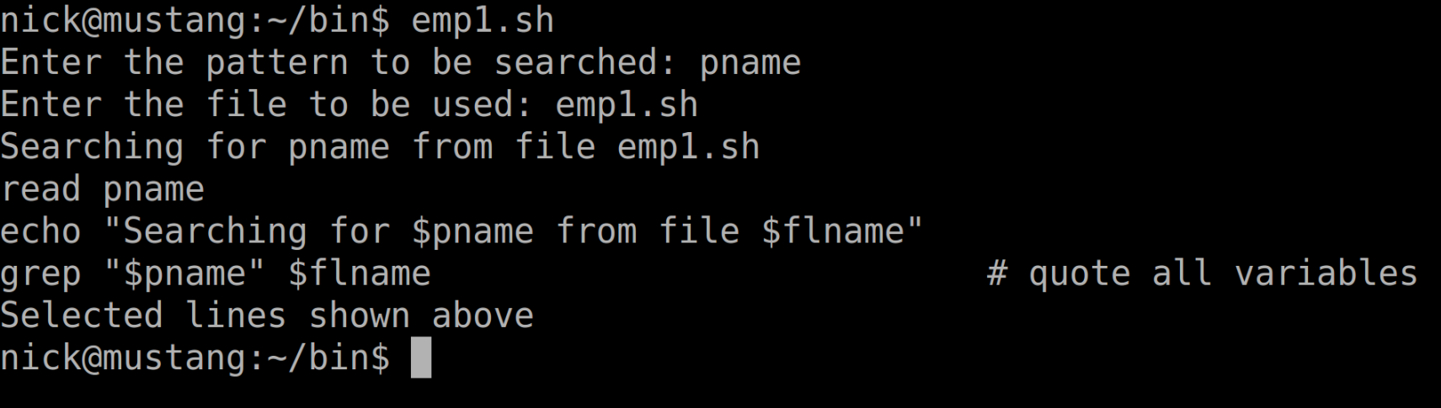
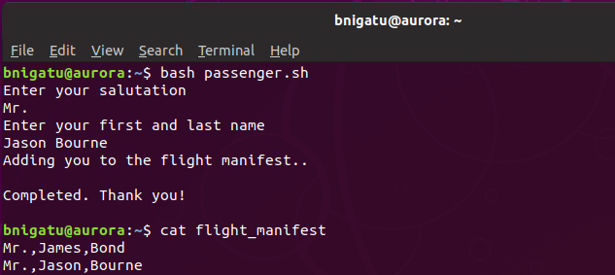
Output from ‘passenger.sh’

Slide 9
Command-Line Arguments
Scripts not using read can run noninteractively and be used with redirection and pipelines.
Like UNIX commands, such scripts take user input from command-line arguments.
The first argument is $1, the second $2, etc. up to $9
Can go beyond with the ‘shift’ statement
Other special parameters:
$* - stores the complete set of positional parameters as a single string
$# - is set to the number of arguments specified
$0 – holds the script filename itself

Slide 10
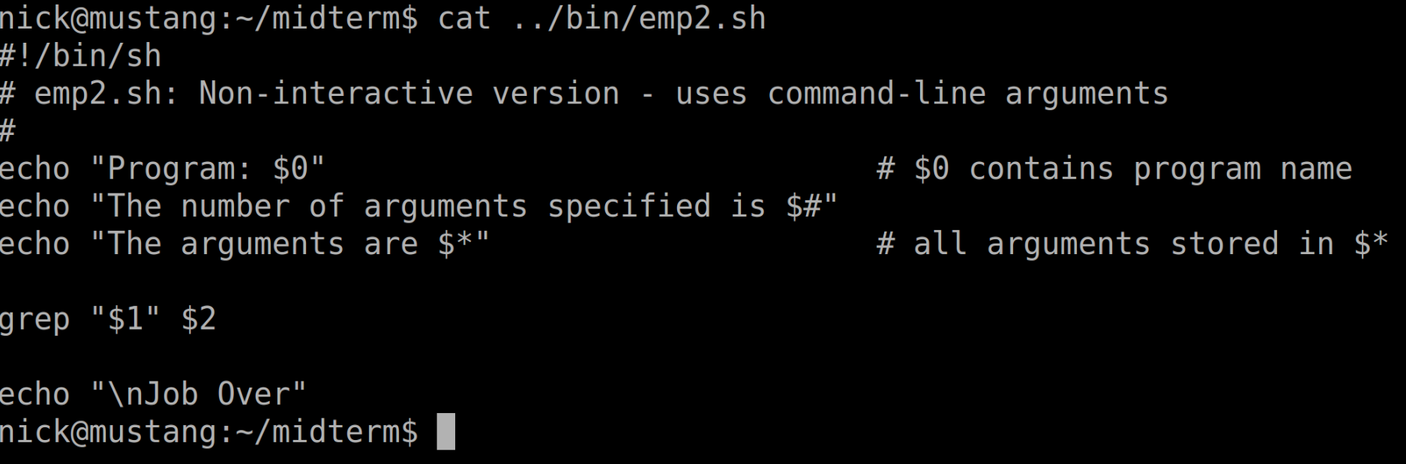
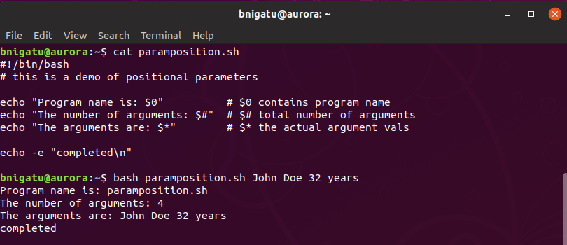
Example of Two Positional Parameters

Slide 11
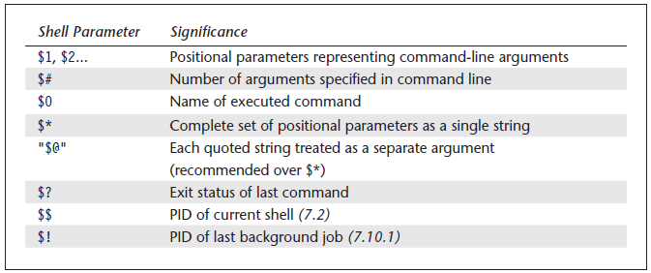
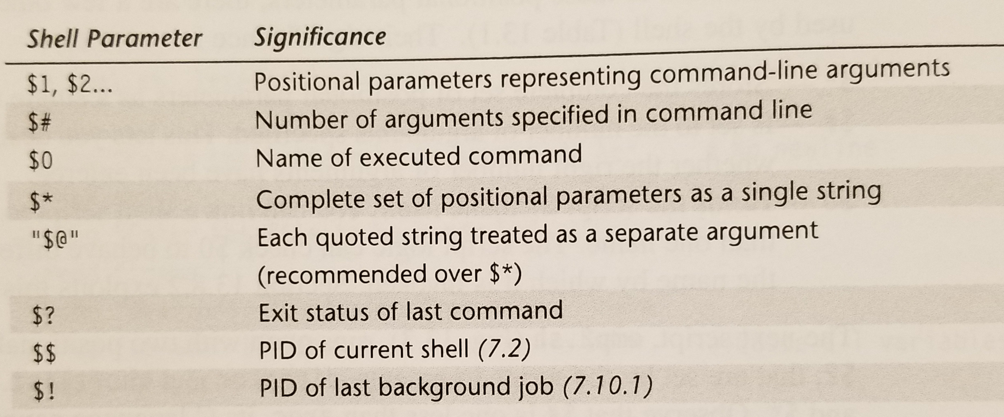
Special Parameters Used by the Shell

Slide 12
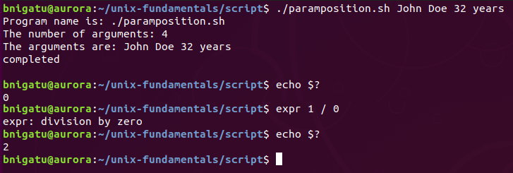
exit and $?: Exit Status of a Command
All programs and shell scripts return a value called the exit status to the caller, often the shell.
exit = Default value is 0
exit 0 = True; everything went fine
exit 1 = False; something went wrong

Slide 13
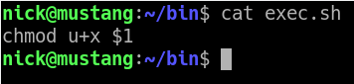
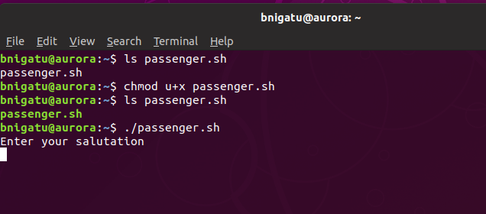
Creating Executable Script (chmod)
So far we were using the bash to execute our script. For example bash “passenger.sh” We can use chmod (which stands for change mode) to make the file executable.
Notice file color is green
To execute you can now use ./filename

Slide 14
Shell Programming, Part II

Slide 15
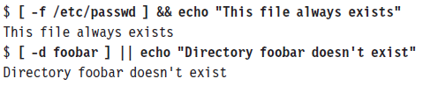
The Logical Operators && and ||
The shell provides two operators that allow conditional execution— the && and || (also used by C), which typically have this syntax:
cmd1 && cmd2 #cmd2 executed if cmd1 succeeds
cmd1 || cmd2 #cmd2 executed if cmd1 fails

Slide 16
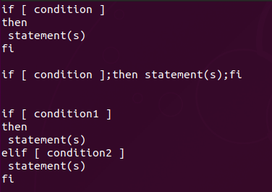
The if Conditional
Almost every programming language has an if/then/else construct, and the shell is no exception.
Except the line break after the word then, all these line breaks are required. Therefore “;” is required if it is written as a one liner.
The spaces around the [ and ] symbols are also required
elif is a construct that allows us to add conditions to the else part of an if statement.

Slide 17
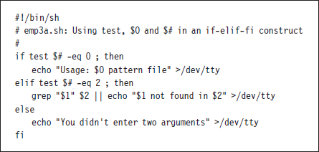
Using test and [ ] to Evaluate Expressions
The if conditional can’t handle relational tests directly, but only with the assistance of the test statement.
[ ]: is a shorthand for test. test is so widely used that fortunately there exists a shorthand method of executing it.
test $x -eq $y is equivalent to [ $x -eq $y ]
if [ $x ] as a shorthand form of if [ $x -gt 0 ].

Slide 18
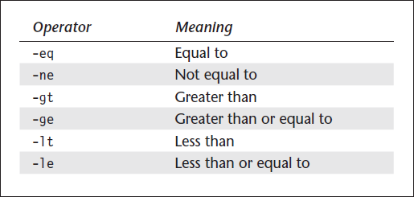
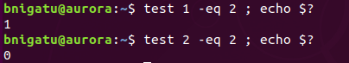
Numerical Comparison Operators test
The numerical comparison operators used by test have a form different from what you would have seen anywhere.
Example: comparing two numbers

Slide 19
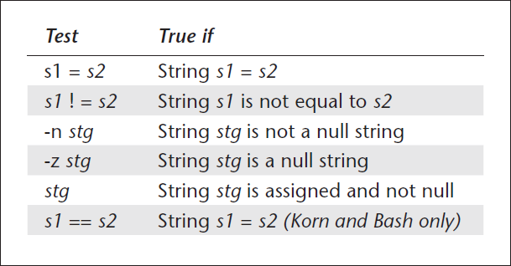
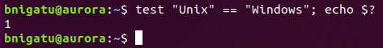
String Tests with test
test can be used to compare strings with yet another set of operators. Equality is performed with = (not ==) in Bourne shell, and inequality with the C-type operator ‘!=‘
Example: comparing two strings

Slide 20
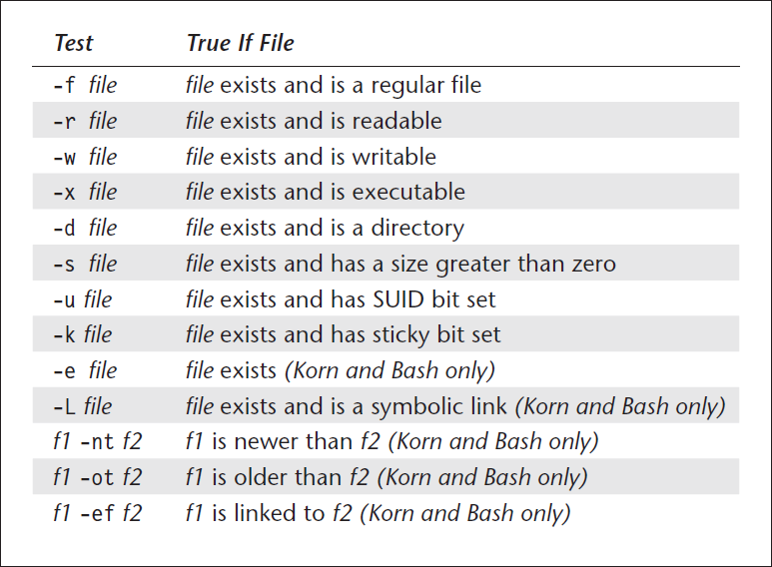
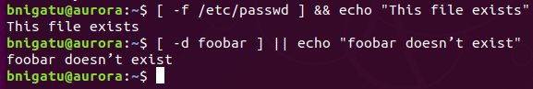
File Attribute Tests
test can be used to test practically all file attributes stored in the inode
For example, the –f and –d operator tests for the existence of a file, and directory respectively.

Slide 21
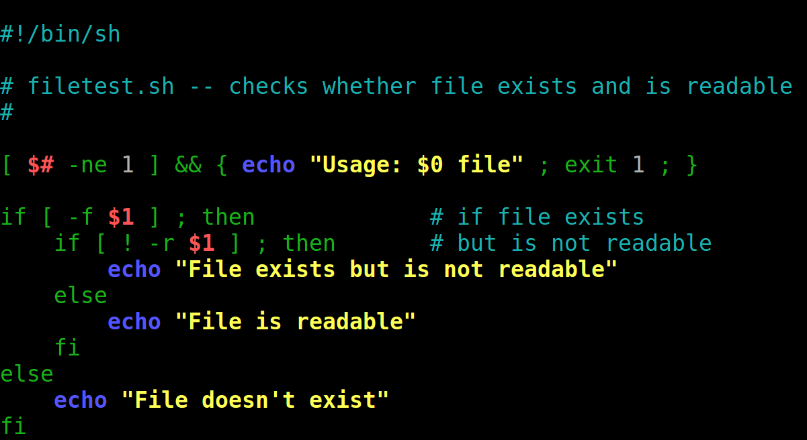
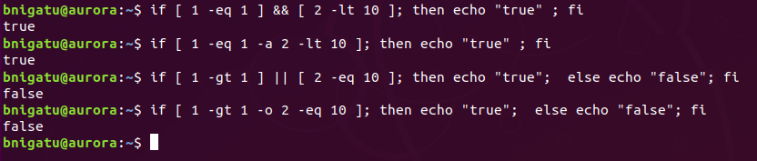
Using Compound Conditions
if and test can also be used with compound conditions.
There are two forms:
one uses the && and | | operators, and
the other uses -a and -o.
Use -a and -o inside square brackets, && and | | outside

Slide 22
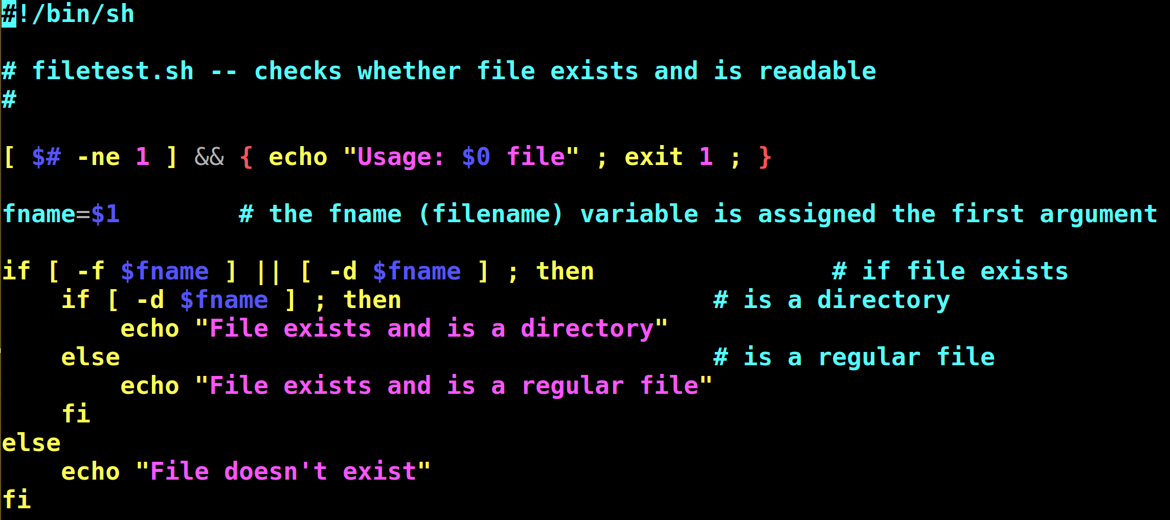
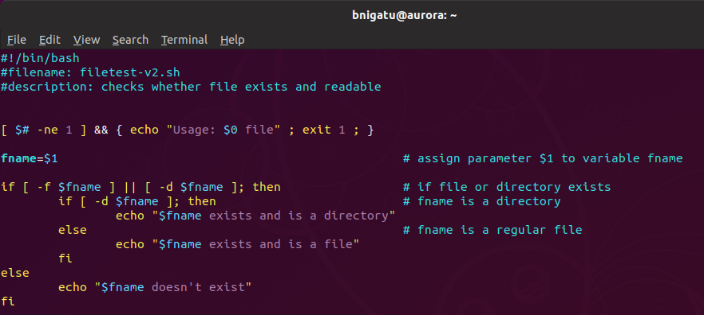
Use of Compound Conditions

Slide 23
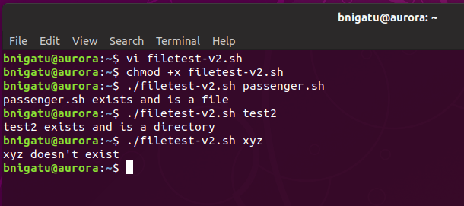
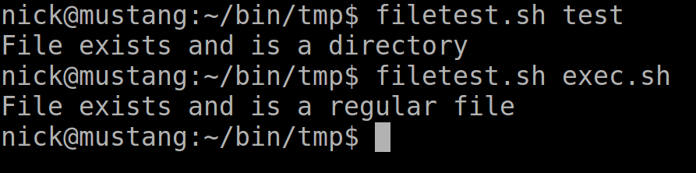
Use of Compound Conditions (output)

Slide 24
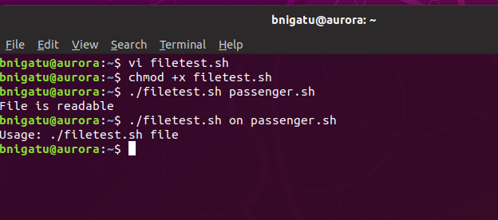
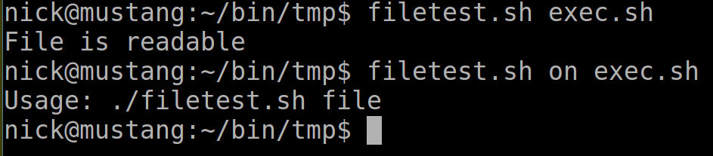
Use of Command Conditions
In the first example, everything is ok.
In the second example, I added an argument – now there are two. The test requires there be only 1 so I get the usage statement.

Slide 25
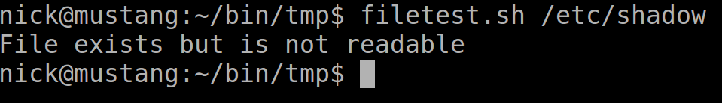
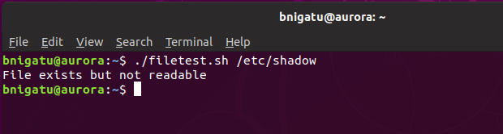
Use of Command Conditions
Encrypted password file

Slide 26
Case Conditional
case statement is the second conditional offered by the shell.
This statement is somewhat similar to the switch statement of C
It easily surpasses the string matching feature of if, because of its compact construct
Structure:
case expression in
pattern1) commands1;;
pattern2) commands2;;
pattern3) commands3;;
…
esac

Slide 27
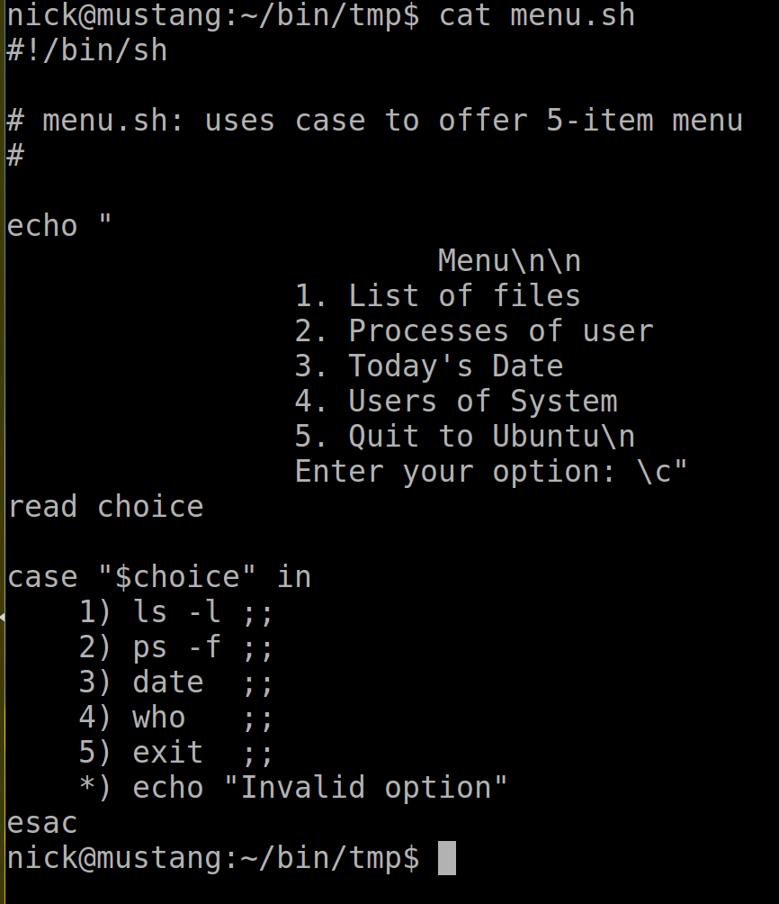
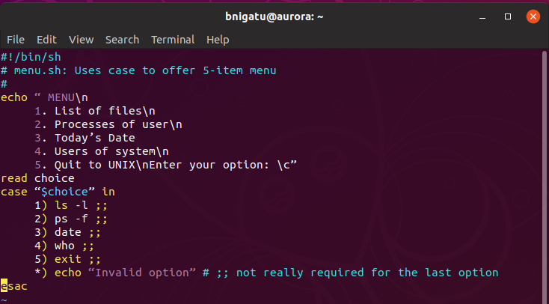
Case Example

Slide 28
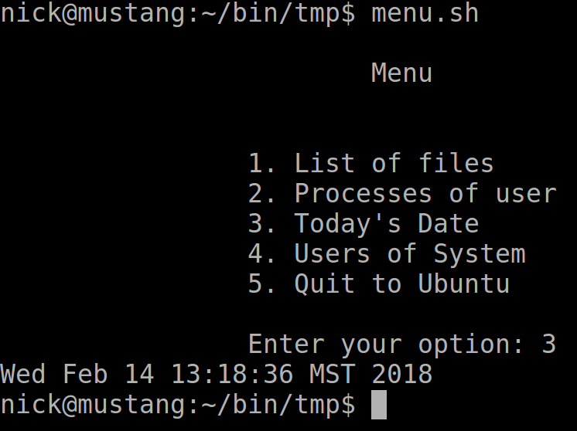
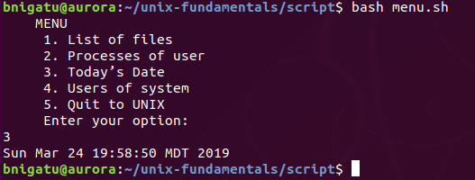
Case Example Output

Slide 29
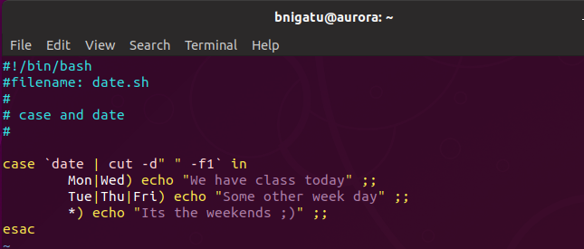
Using Wild Cards and the ‘|’
‘case’ delimits multiple patterns with a ‘|’
Example:

Slide 30
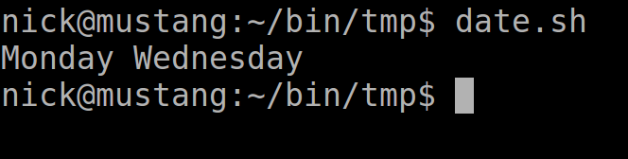
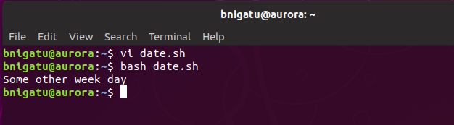
Using Wild Cards and the ‘|’

Slide 31
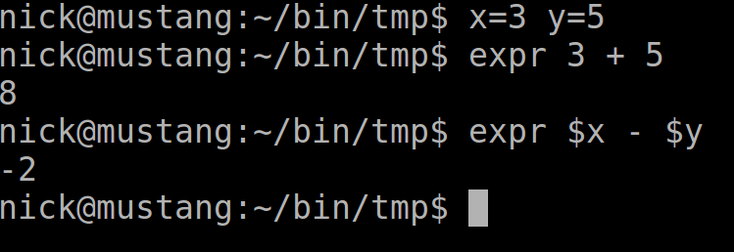
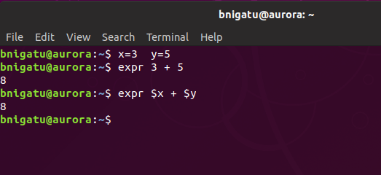
Computational Handling with ‘expr’
expr performs the four basic arithmetic operations and the modulus (remainder) function. It handles only integers; decimal portions are simply truncated or ignored.

Slide 32
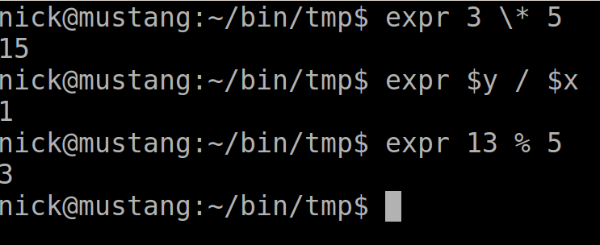
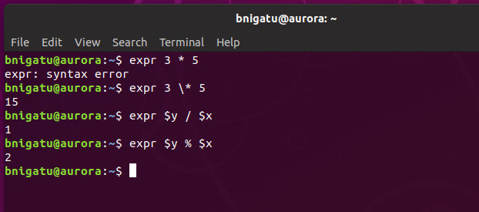
Computational Handling with ‘expr’

Slide 33
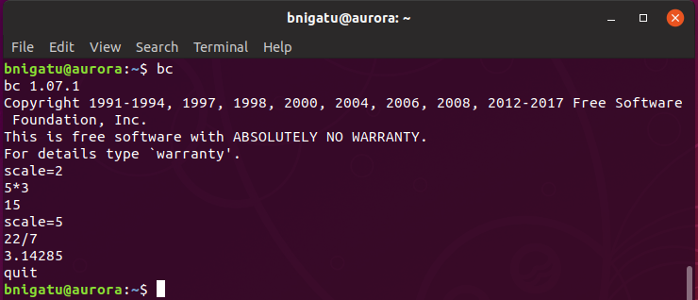
Floating Point with ‘bc’
‘expr’ cannot handle floating point – that’s where ‘bc’ comes in
‘bc’ is an environment
‘scale’ sets the number of decimal points

Slide 34
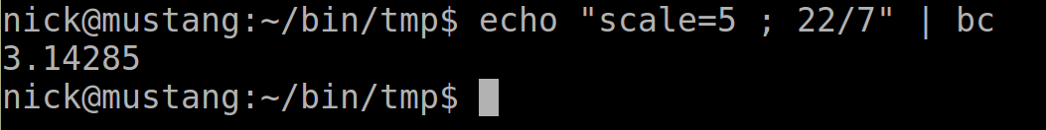
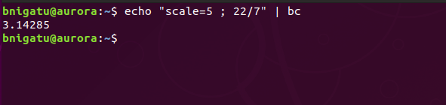
‘bc’ Accepts Input from Pipes

Slide 35
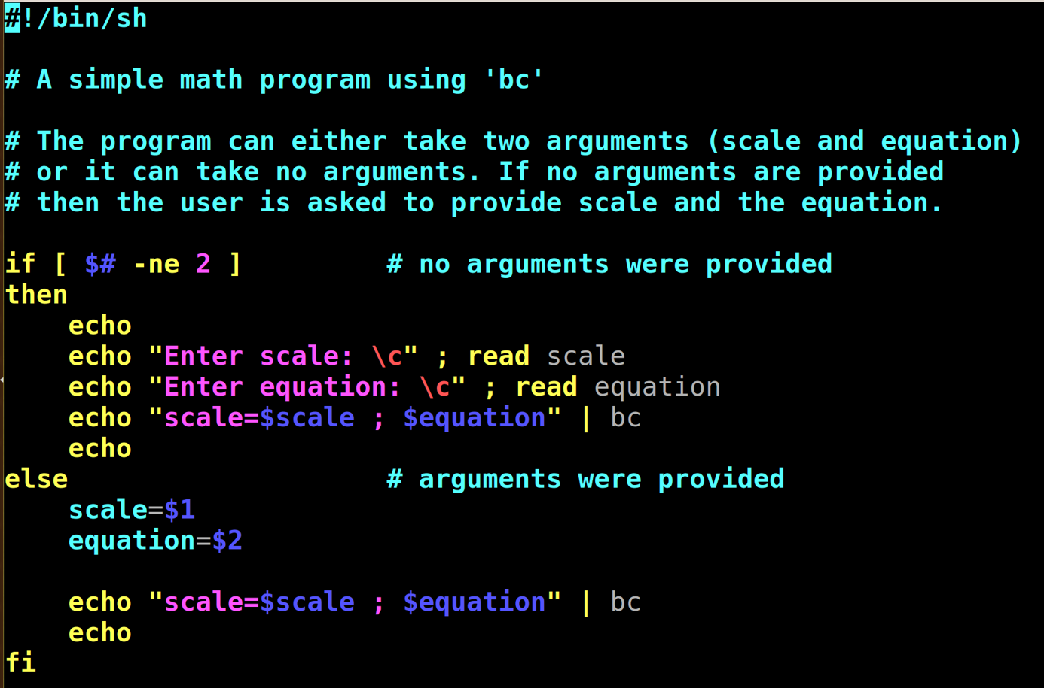

The ‘bc’ Program

Slide 36
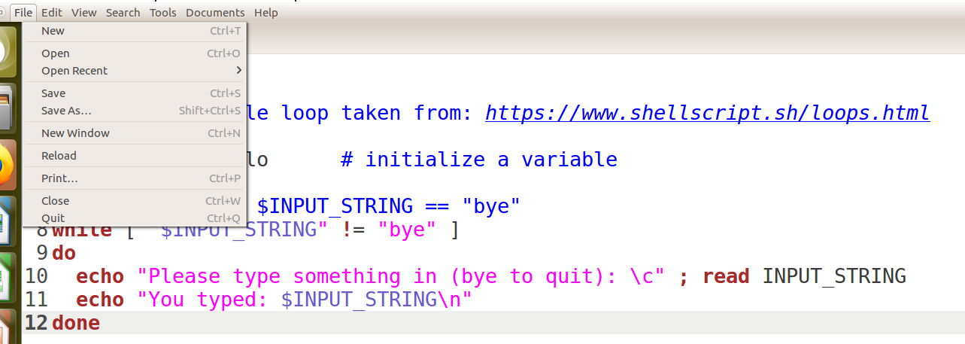
‘gedit’ Editor ***
‘gedit’ is the Ubuntu default text editor
Type ‘gedit <filename>’ or ‘gedit <f1> <f2> … <fn>’

Slide 37
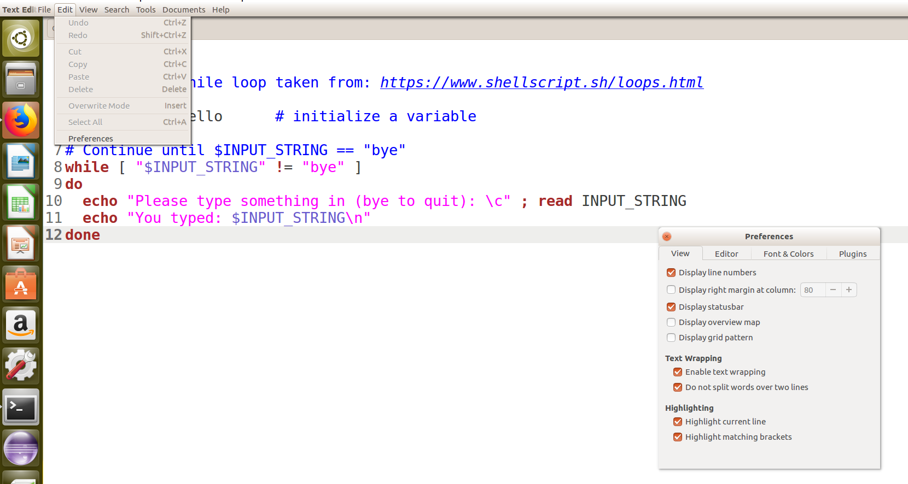

‘gedit’ Editor Continued

Slide 38
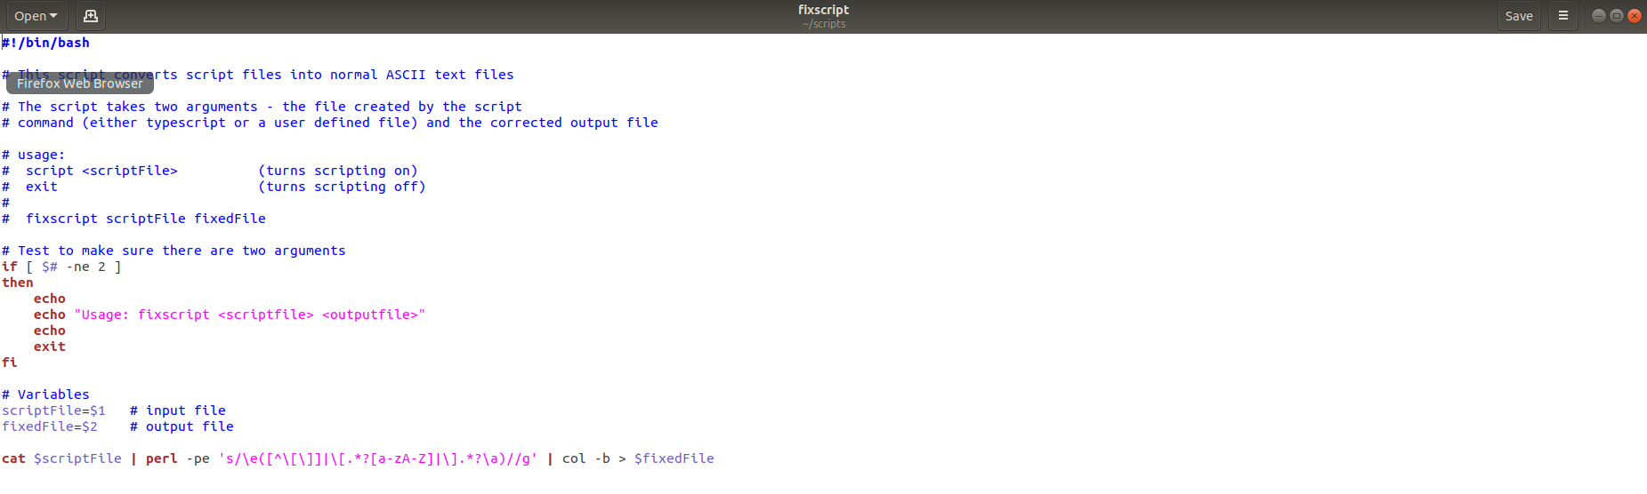
GEDIT on Ubuntu 18.x
Save As, etc.
MS Windows-CUI

Slide 39

GEDIT on Ubuntu 18.x

Slide 40

‘gedit’ Editor Install
If you do not have ‘gedit’ installed, run the following
Try ‘gedit’ first before trying to install

Slide 41
‘for’: Looping with a List
Three types of shell loops include: ‘for’, ‘while’, and ‘until’
A key part of any programming and scripting language is the ability to run the same piece of code again and again
A ‘for’ loop repeats a certain section of the code over and over
A ‘for’ loop is useful so that a series of commands can keep running until a particular condition is met, after which the loop will stop.
‘for’ uses a list – syntax is:
for variable in list
do
commands
done
‘do’ and ‘done’ bound the loop body, e.g. everything within ‘do’ and ‘done’ are performed as part of the ‘for’ loop

Slide 42


‘for’ Looping with a List Example
At every iteration, each word in list is assigned to variable, and commands are executed. The loop terminates when list is exhausted. Multiple examples are given to help you understand things better

Slide 43


‘for’ Looping with a List Example Output

Slide 44

‘for’ Loop Conditions
The values after the word "in" make up the list to iterate through and each value in the list is placed in the variable
The curly brackets {} basically denotes a range, and the range, in this case, is 1 to 20 (the two dots separate the start and end of a range)
Imagine you want to loop between 0 and 100 but only show every tenth number. The following script shows how to do that:

Slide 45


‘for’ Loop Example Output

Slide 46


‘for’ Loop Example #5 (C/C++ like)

Slide 47


‘for’ Loop Example Output

Slide 48
Chapter 13, Part III

Slide 49
‘while’ Loops
Also uses keywords ‘do’ and ‘done’ like ‘for’ loops
Does not work with lists; uses a control command similar to the ‘if’ statement
As in ‘if’, you can use any UNIX command or test as the condition
‘x=5 # must have an initialized variable before using ‘while’
while [ $x –gt 0 ] ; do
ps –e | head –n 2 ; sleep 3
x=`expr $x – 1` # in this example, we use expr for computation
Done’

Slide 50


‘while’ Loop Example 1
Initialized variable

Slide 51


‘while’ Loop Example 1 Output

Slide 52


‘while’ Handling Redirection
0 = standard in (STDIN)
1 = standard out (STDOUT)
2 = standard error (STDERR), thus, ‘1>&2’ means redirect file descriptor 1 (STDOUT) to standard error (STDERR)
In this version, ‘1&2’ doesn’t do anything.
Using ‘>>’ results in the addressbook being open and closed with each entry.

Slide 53


‘while’ Handling Redirection Output

Slide 54

Using while to Wait for a File
There are situations when a program needs to read a file created by another program, but it also has to wait until the file is created.

Slide 55

Using while to Wait for a File Output
Be on animation mode to see the result.

Slide 56


‘while’ Loop Example 3 with ‘break’

Slide 57


‘while’ Loop Example 3 Output

Slide 58

UNTIL Loop ALWAYS Executes at Least Once
Unlike ‘while’ that executes some commands while some condition is true,‘until’ executes until some condition is true.
In the example, we start off with false, e.g. ! (not).
Syntax:
until <command>
do
statements executed until command is true
done

Slide 59

Setting Positional Parameters with set
set assigns the values of its arguments to positional
parameters (like $1, $2, etc.) as well as $#, $*, and “$@”
If the command doesn’t produce an output, and set responds by displaying ..... All shell variables shown .....
If the output begins with a hyphen, set interprets as a “bad option” the solution is to use - - after set: set - - `ls -l unit01`

Slide 60


Shifting Positional Parameters with shift
shift transfers the contents of a positional parameter to its immediate lower-numbered one. $2 becomes $1, $3 becomes $2, and so on
If the leftmost parameter(s) is/are important, it/they must be saved before invoking shift
In the example to the right there is a simple while loop that will run till all arguments are shifted and removed from the stack.
Output

Slide 61
Shell Functions ***
Syntax:
Function_name() {
statements
return value
}
Shell functions can return a value such as 0 for success or 1 for fail

Slide 62

Shell Functions
A shell function executes a group of statements enclosed within curly braces.
It optionally returns a value with the return statement.
Unlike in C, a function definition uses a null argument list, but requires ()
In the example to the right the factorial function will accept an input parameter $1 and computers its parameter.

Slide 63

trap: How a Script Handles Signals
Shell scripts terminate when the interrupt key is pressed unless you use the trap statement to specify a different action.
trap is a signal handler, and it is normally placed at the beginning of a script.
trap uses two lists
trap ‘command_list’ signal_list

Slide 64

eval: Evaluating Twice
eval is a unix command that can be used to execute the arguments as a shell command on shell.
For example : Executing cmd=”ls | head -5”; $cmd doesn’t list the content of the current directory.
The solution is to use eval.
Redirect error to null device
Evaluates command in cmd

Slide 65
Chapter 13 In-Class Exercise

Slide 66

Create a WHILE Loop

Slide 67

IF within WHILE and BREAK

Slide 68

MENU with WHILE

Slide 69

MENU, CASE with WHILE

Slide 70

MENU, CASE, WHILE, & IF

Slide 71

CREATE DATABASE,
SAVE Data Embedded
WHILE & CASE

